Slide 1
Summary Report for BFX–UA300
Quality Issue on June-2022 Product.
Prepared by: Rachel Ruan
Reviewed by: Toney Tu
Approved by: CB Lin
Date: 2022-Sep-07

Slide 2
Issue Description
30-Aug-2022, ALT customer complain [BFX-UA300] 2022.June Mass production issue.
Overall inspection result => Apply full (4000pcs) inspection
Defect Total:
Critical
• FFC cable defect : Total 5pcs defect
• For FFV MIC defect 1pcs - FFV Mic not work issue.
• For Button FFC defect : 2 pcs
1. Button function not work (BT and Mic mute button)
2. Button function not work (CH-)
• For Amp FFC defect : 2pcs - No Sound output issue
Major
• Cosmetic defect –
1. Top case scratch 6 pcs
2. Painting defect 2pcs
• Accessary defect - HDMI cable defect 5 pcs
Minor
• Tact feeling NG 1pcs

Slide 3
1. For FFV MIC defect 1pcs - FFV Mic not work issue
Issue Description | FA | Root cause | Actions | Status
Symptom: FFV Mic not work issue Type: Critical Defect unit Q’ty : 1/2016pcs Defect rate : 0.049% SKB SN: 2149695001202201011706 | 1. Fail symptom: As ALT feedback that they found out 1pcs MIC not working 2. Check FATP data → product pass normally At FT2 station: test program test MIC function 3. Suggestion: - Take X-ray and VI MIC FFC cable. - Swap NG FFC cable with OK product (MIC FFC cable connect between K18X001T00 main board and 96.1516T00 MIC board) + If swap result is OK ➔ Re-assembly NG MIC FFC cable to the original product + If swap result is NG ➔ This issue follow material - Check MIC FFC cable open/short or not | Waiting NG FFC cable for analysis | 1. Online product fix OP at assembly station, special assembly FFC cable . Status : Done 2. Add on flowchart and SOP – Assembly FFC cable K18X001T00 with AMP board is CTQ station (Critical to quality) Owner: PD – Van Anh 07-Feb-2022 Status : Done | Monitor

Slide 4
2. Button function not work (BT and Mic mute button)
Issue Description | FA | Root Cause | Action | Status
Symptom: For Button FFC defect - BT and Mic mute button Type: Critical Defect unit Q’ty : 1/2016pcs Defect rate : 0.049% SKB SN: 2149695001202201010911 | 1. Fail symptom: As ALT feedback that they found out 1pcs BT , Mic mute function not work and 1pcs CH- function not work. 2. Check FATP data → product pass normally At FT1 station: test program test button function twice 3. Suggestion: - Take X-ray and VI Button FFC cable. - Swap NG FFC cable with OK product (Button FFC cable connect between K18X001T00 main board and 96.1517T00 Button board) + If swap result is OK ➔ Re-assembly NG FFC cable to the original product + If swap result is NG ➔ This issue follow material - Check Button FFC cable open/short or not | Waiting NG FFC cable for analysis | 1. Online product fix OP at assembly station, special assembly FFC cable . Status : Done 2. Add on flowchart and SOP – Assembly FFC cable K18X001T00 with AMP board is CTQ station (Critical to quality) Owner: PD – Van Anh 07-Feb-2022 Status : Done | Monitor

Slide 5
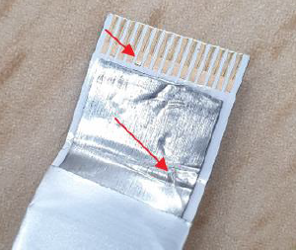
3. Button function not work (CH-)
Issue Description | FA | Root cause | Actions | Status
Symptom: For Button FFC defect – CH button Type: Critical Defect unit Q’ty : 1/2016pcs Defect rate : 0.049% SKB SN: 2149695001202201009565 | 1. Fail symptom: As ALT feedback that they found out 1pcs BT , Mic mute function not work and 1pcs CH- function not work. 2. Check FATP data → product pass normally At FT1 station: test program test button function twice 3. Suggestion: - Take X-ray and VI Button FFC cable. - Swap NG FFC cable with OK product (Button FFC cable connect between K18X001T00 main board and 96.1517T00 Button board) + If swap result is OK ➔ Re-assembly NG FFC cable to the original product + If swap result is NG ➔ This issue follow material - Check Button FFC cable open/short or not | Waiting NG FFC cable for analysis | 1. Online product fix OP at assembly station, special assembly FFC cable . Status : Done 2. Add on flowchart and SOP – Assembly FFC cable K18X001T00 with AMP board is CTQ station (Critical to quality) Owner: PD – Van Anh 07-Feb-2022 Status : Done | Monitor

Slide 6
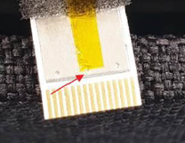
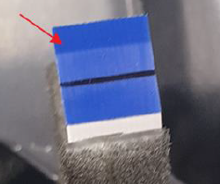
4. For Amp FFC defect : 2pcs - No Sound output issue
Issue Description | FA | Root cause | Actions | Status
Symptom: For Amp FFC defect : 2pcs/2016 pcs Type: Major Defect rate : 0.09% SKB SN: 2149695001202201008576, 2149695001202201011157 | 1. Fail symptom: As ALT feedback that they found out 2pcs No sound output 2. Check FATP data → pass normally → On FATP : Sound function tested at FT2 station (With factory software) and RC1 station ( With customer software) 3. Suggestion - Take X-ray and VI AMP FFC cable. - According to the customer’s picture realize that pin 8 (AMP I2C SCL) and pin 9 ( GND) have problem ➔ Focus on check short between pin 8 and pin 9 → If pin 8, pin 9 are short together or open➔ Can’t check AMP version at FT1 , FT2 station | Waiting NG FFC cable for analysis | 1. Online product fix OP at assembly station, special assembly FFC cable . Status : Done 2. Add on flowchart and SOP – Assembly FFC cable K18X001T00 with AMP board is CTQ station (Critical to quality) Owner: PD – Van Anh 07-Feb-2022 Status : Done | Monitor

Slide 7
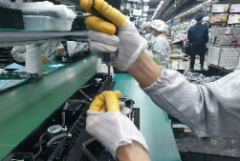
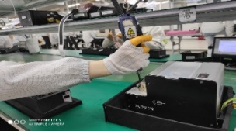
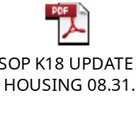
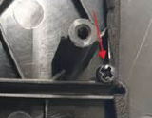
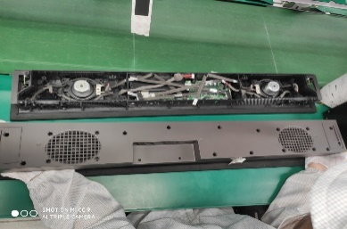
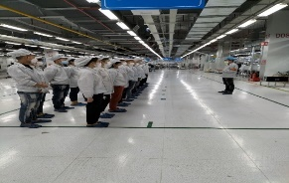
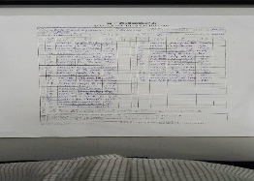
5. Screw inside
Issue Description | Root Cause | Actions | Status
Symptom : Noise occurs when shaking the product Type: Minor Defect unit Q’ty : 1/2016 pcs Defect rate : 0.049% SN:2149695001202201010065 | 1. This station maybe OP use hand take screw out machine drop inside product, OP no upside down product before final Top case housing. ( SOP define it ) 2. At visual inspection station, OP shaking the product no detect out strange noise. | 1. Doing follow SOP ( SOP define take screw by machine, not by hand). Status : Done 2. Request each OP doing must have self check, re-check and final check. Status : Done 3. Before run line , line leader training OP, notice quality online issue, IPQC defect issue, OBA issue, read SOP and quality alarm. Status : Done | Monitor

Slide 8



6. Cosmetic issue
Issue Description | Root Cause | Actions | Status
Symptom : Cosmetic issue Housing painting defect Type: Major Defect unit Q’ty : 2 / 2016pcs Defect rate : 0.099% SN : 2149695001202201010888 2149695001202201009197 | Housing incoming painting issue, feedback to Inkel vendor and request 8D report to Inkel Quality team . Due date: 08-Sep-2022 Add to IQC-SIP checking housing incoming the NG picture ( Painting housing issue ). | Hang quality alarm on IQC control housing incoming this issue, if IQC defect, will reject housing back vendor. Status: Done Hang quality alarm on VI station and OBA station for OP doing notice it. Status : Done | Done

Slide 9
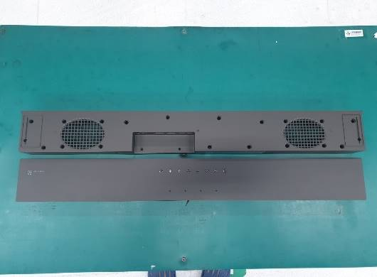
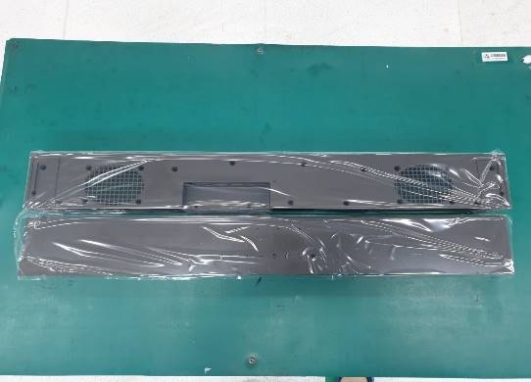
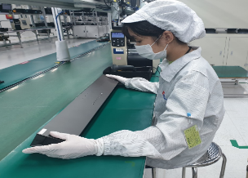
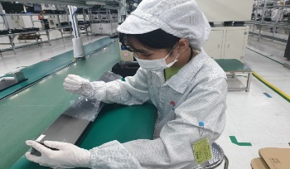
7. Cosmetic issue
Issue Description | Root Cause | Actions | Status
Symptom : Cosmetic issue Top housing scratch issue Type: Major Defect unit Q’ty : 5 / 2016pcs | TOP & BOT housing scratch ( without feel ) on AA side and A side . Add to IQC-SIP checking housing incoming the NG picture ( housing scratch ). Notice OP check follow SOP and quality arlam when VI product, special AA side , logo and text slitter location online production and OBA station. | Hang quality alarm on IQC control housing incoming this issue, if IQC defect, will reject housing back vendor. Status: Done Hang quality alarm on VI station and OBA station for OP doing notice it. Status : Done Housing incoming improved , add more Mylar on Top housing cover scratch issue. Done | Done
Before improved housing incoming
After improved Add Mylar on housing incoming

Slide 10
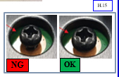
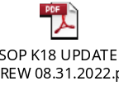
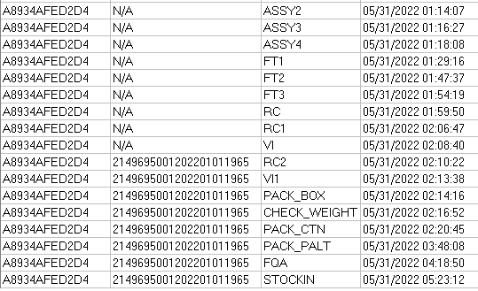
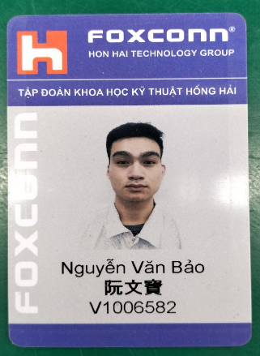

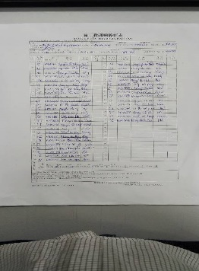
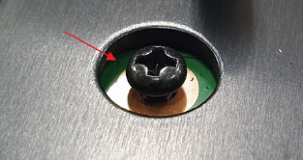
8. Tact feeling is not good
Issue Description | FA | Root cause | Actions | Status
Symptom : tact feeling is NG Type: Minor Defect unit Q’ty : 1 / 2016pcs Defect rate : 0.049% S/N : 2149695001202201011965 ALT Function check : No found abnormal, but tact feeling NG Visual check : found abnormal - Screw fully fastening. | 1. Fail symptom: As ALT feedback that they found out 1pcs tact feeling is not good 2. Check FATP data SN , test function and visual inspection ➔ Pass normally. | 1. OP assembly Button main doing no follow SOP, Screw need confirm by 2 “cach cach”. 2. OP no re-check by himself before transfer to next station. 3. OP doing this station : V1006582 Nguyen Van Bao. | 1. Re-training OP doing follow SOP. Status : Done 2. Update NG picture to SOP. Quality alarm hang online for OP notice it. Status : Done 3. Before run line , line leader training OP, notice quality online issue, IPQC defect issue, OBA issue, read SOP and quality alarm. Status : Done | Monitor

Slide 11
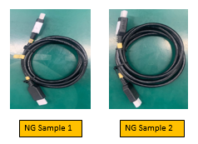

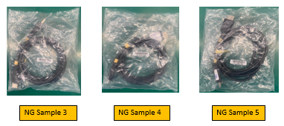
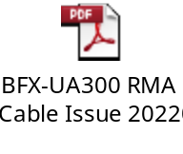
9. HDMI cable defect
Issue Description | Root cause | Actions | Status
Symptom: HDMI cable defect Defect Q’ty : 5 pcs / 1088 D/C: 220421 & 220413 | FIT HDMI cable material issue. The pin copper wire of HDMI cable is broken & pin copper wire is not placed properly and is not placed in the corresponding pin slot. | Short term action: FIT 100% sorting the HDMI cable, sorted 35,242pcs, no defect found. (Done on Aug-17) Stock D/C: 220615, 220624, 220708, 220715 (FIT received 5pcs defect HDMI cables at May, and the improved D/C from 220601, so no defect found after sorting). Fii changed the HDMI cable of 1,080 FG units with sorted HDMI cable. ( Done on Aug-10) Long term action: FIT improved the HDMI cable from D/C 08.2022. | Close

